Slide 1



World Sustainability Fund
Creating The World We Need, Together

Slide 2
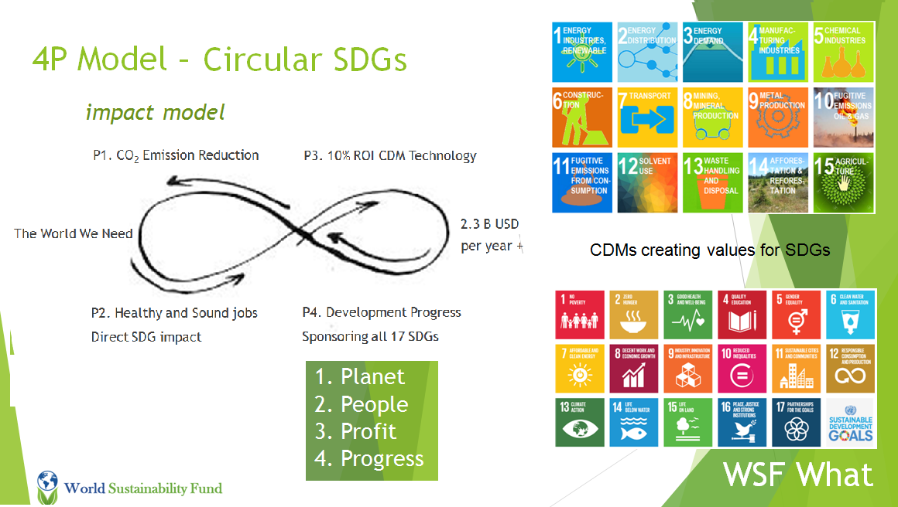

Slide 3

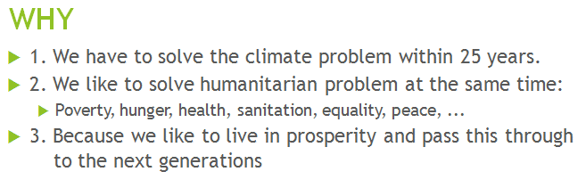

Create The World We Need Together
By transforming our lives,work, social structures & economics

Slide 4
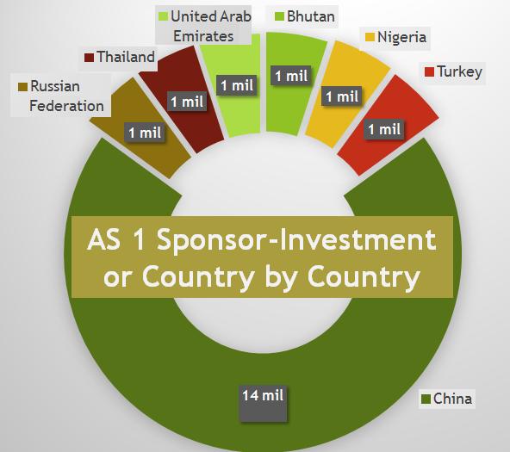
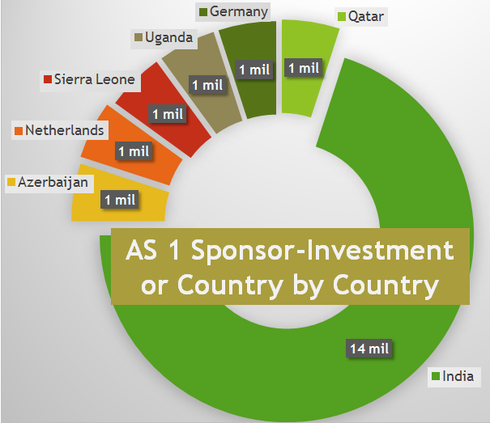

40 M$ SPONSOR-INVESTMENT
3rd offer
+ 45%
of global
population

Slide 5
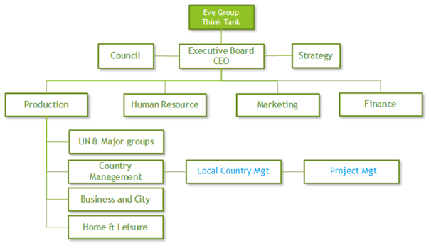
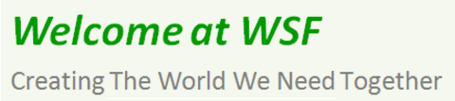
New Board & Council per 2017
For the Board:
Lin Luo – President
Zaida Abdoel – Secretary, HRM & Mgt Bureau
Harold N. Dhalganjansing - Treasurer & Finance
Ahmad Ashan - Vice Treasurer & Finance
Nicola Hornsby ‐ Informatics & Security
Marieke Obdam - Vice Marketing & Sales
Danny Giesbers ‐ Strategy
For the Council:
Emile van Essen - President
Güniz Çulcu Van Cres – Secretary
Lisinka Ulatowska – U.N. Relations
Eduard – Treasurer ?

Slide 6
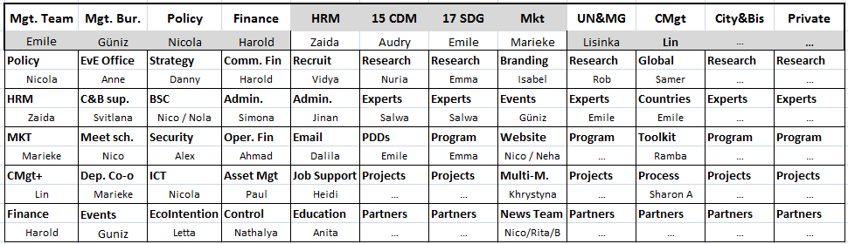
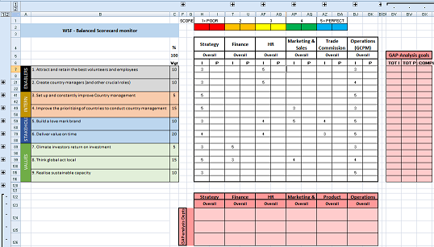
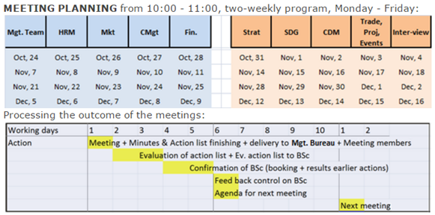
Departments, Units & Process Modeling
BSc
Targets
Meeting
plan
Alignment
Protocol

Slide 7
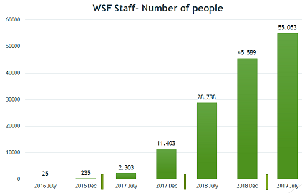
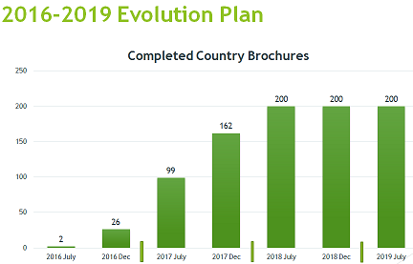
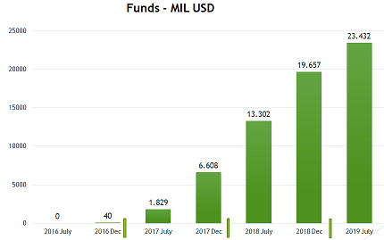

Slide 8

Climate and Social Economic Solutions
1. The United Nations arranged technological green standards – CDM
2. And asked every country to write a green and social plan – INDC
3. Also they asked financial institutions to support – CDP
4. Then they delivered a global Agenda 2015–2030 – SDG
5. And asked everyone to support, so …
WSF supports with massive capacity building
By connecting those points
For best practice samples
In every country within three years
WSF How

Slide 9
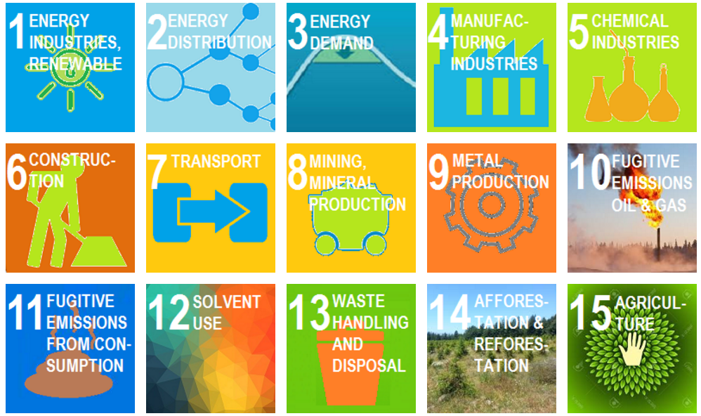

WSF Country Program, sample
Priority Projects Profiles Amount in USD
Renewable Energy (WIND) | 10,000,000
Renewable Energy (SOLAR) | 10,000,000
Renewable Energy (HYDRO) | 10,000,000
Energy Distribution | 10,000,000
Energy Demand | 10,000,000
Transportation | 10,000,000
Waste Handling | 10,000,000
Afforestation | 10,000,000
Reforestation | 10,000,000
Agriculture | 10,000,000
Sponsor Investment 0.5 till 1% | 100,000,000
Program
under
U.N. protocol
CDMs creating values for SDGs
WSF What

Slide 10
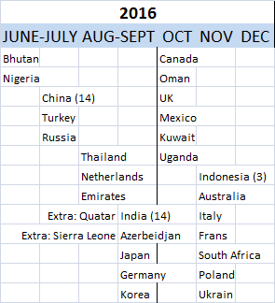

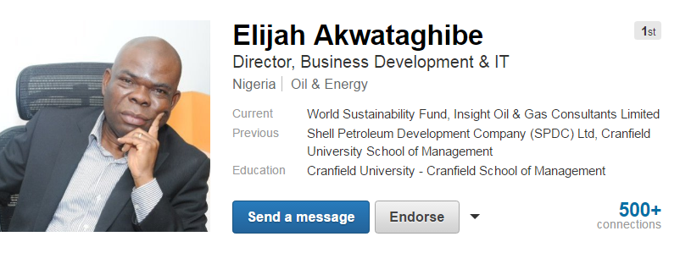
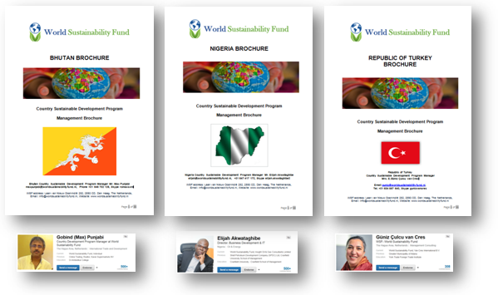




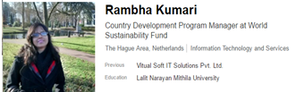
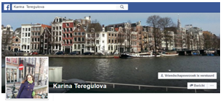
… Country Manager, Sample

Slide 11
Production & structured finance
Core Management
Board – Council and Policy
Head Quarter – HR, MKT, Finance Departments +
Global Country Management – Planning, Monitoring, Support, Report
14 Countries
40M$
Brochures ready
26 Countries
30M$
Brochures ready 2016
2017
every month
10 Countries Brochures
10M$/month
2018
4 months
10 Countries Brochures
10M$/month
Organisation Experts
MGT – Country Management Experts
MKT – Local Marketing Experts
FIN – Financial Planning Experts
14 Country Mgt Teams: To be Selected, trained; start, support
26 Country Mgt Teams: To Select, train; start, support
2017
Country Mgt Teams: To Select, train; start, support
2018
Country Mgt Teams: To Select, train; start, support
Technology Experts
PDD – Project Design Document Experts, >20 Experts
CDM – Clean Development Methodologies, Sector 1-15, >45 Experts
SDG – Sustainable Development Goals 1-17, >51 Experts

Slide 12
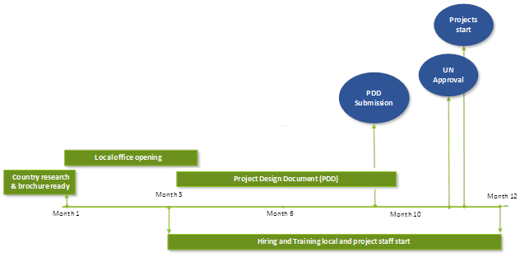
Overview initial project design on paper for UN CER and start of implementation
Creating
The World We Need
Together

Slide 13
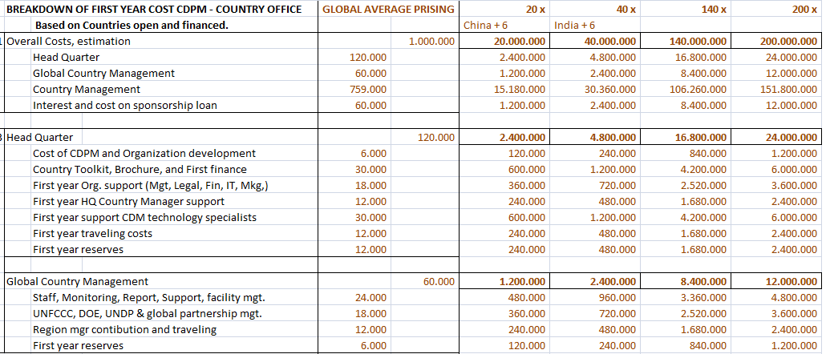
PDD Income & Spending Plan

Slide 14
CDPM COUNTRY 1ste Year, 1 MIL USD PLAN
HQ 12%
Finance 6%
Global CDPM 6%
% from 1M$, Developing 10 Projects, 100M$
Local cost 76%

Slide 16
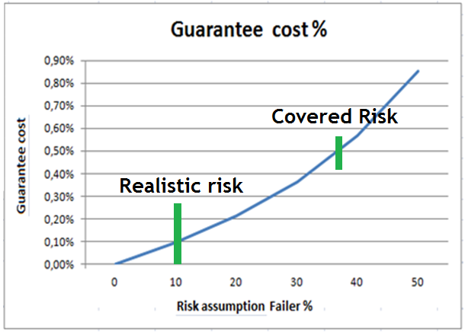
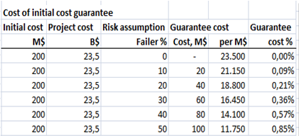
Financial risk - Initial investment
Coverage by project investment

Slide 17
Sign the Sponsor-Investor Agreement Benefits
Contribute to the biggest challenges of the era: saving humanity & climate
Recognition of sponsor/investor within WSF both online and offline
Inclusion in all advertising and event promotional pieces
Opportunity to use the WSF logo company social involvment
Participation of shareholders to WSF events
Advice & support in promoting sustainability in their own company
First right of investments in the local projects
WSF allocates a responsible person for the investor to support them with information & needs updates
Paying annual interest guarantee of money investment & interest back within 2 year

Slide 18
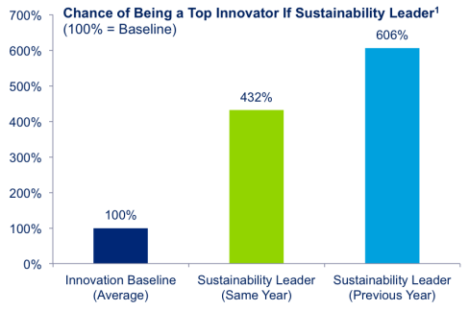






We have a leading vision …
Contact
WSF, Laan van NOI 252, 2593 CD, Den Haag
Emile van Essen, 0658 958 108
emile@worldsustainabilityfund.nl
Sbfemile
http://worldsustainabilityfund.nl/
1 Source

